Slide 1
Bus delay clusters from Translink data
Ulas Ozdemir, Ish Mukul, Mahdieh Malekian, Yee Fay Lim, Emma Lathouwers

Slide 2
Problem setup
Clustering on bus stop locations
Clustering on delay types
53 features
4 months of delays
Both continuous and categorical variables
Delay event info, weather, day & time, …
Challenges
Reducing the number of features
Dealing with both continuous and categorical variables

Slide 3
Approach
Everyone did some EDA
Attempts to reduce features
PCA
Correlation/ pair plot + choose by eye
Focus on subset of data, e.g. only consider weekdays or only delays longer than xx
One-hot encoding for categorical data
K-Means, GMMs, hierarchical clustering
Euclidian, Manhattan, Gower distance

Slide 4
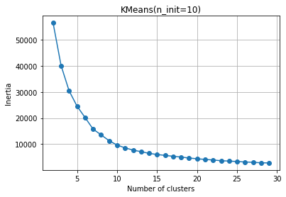
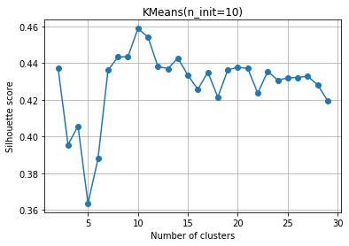
Bus location clustering
K-Means clustering on bus stop locations
Silhouette score to determine optimal number of clusters
Tried k=10 and k=11

Slide 5
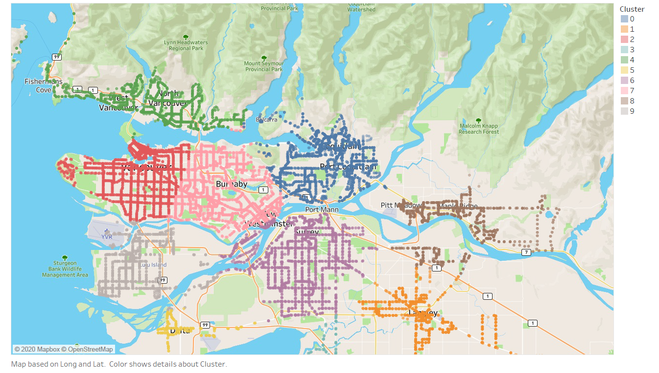
k=10 is great!

Slide 6
Delay event clustering 1
K-Means
Standardize data
How many clusters?
Important features?

Slide 7
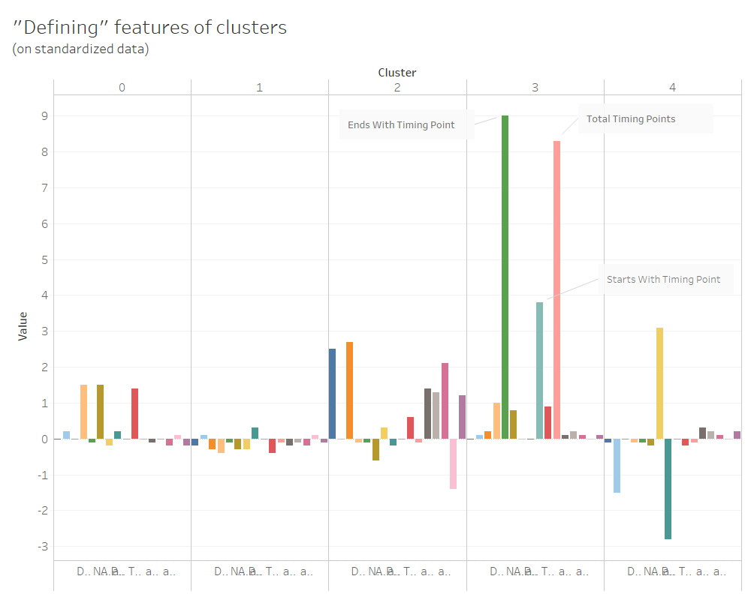
‘Defining’ features of clusters
k=5

Slide 8
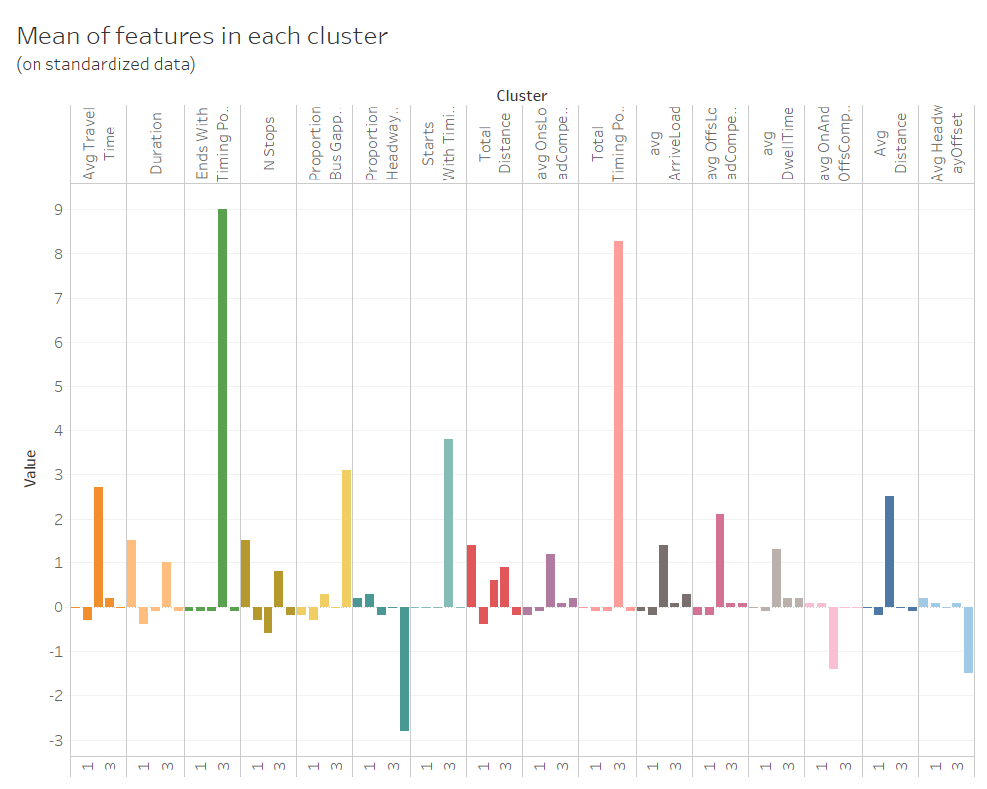
Mean features in each cluster

Slide 9
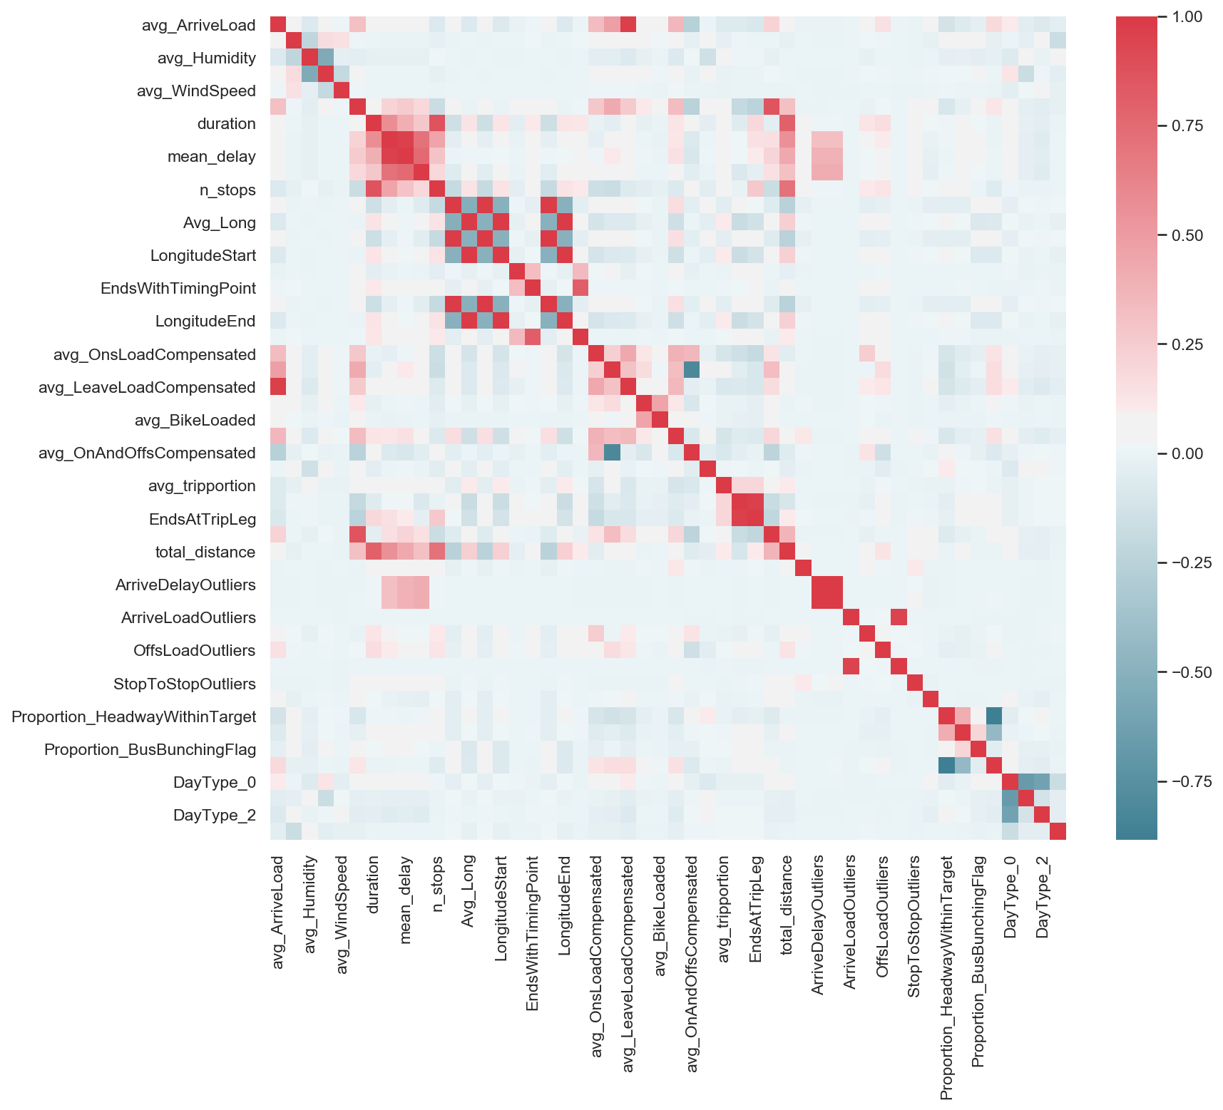
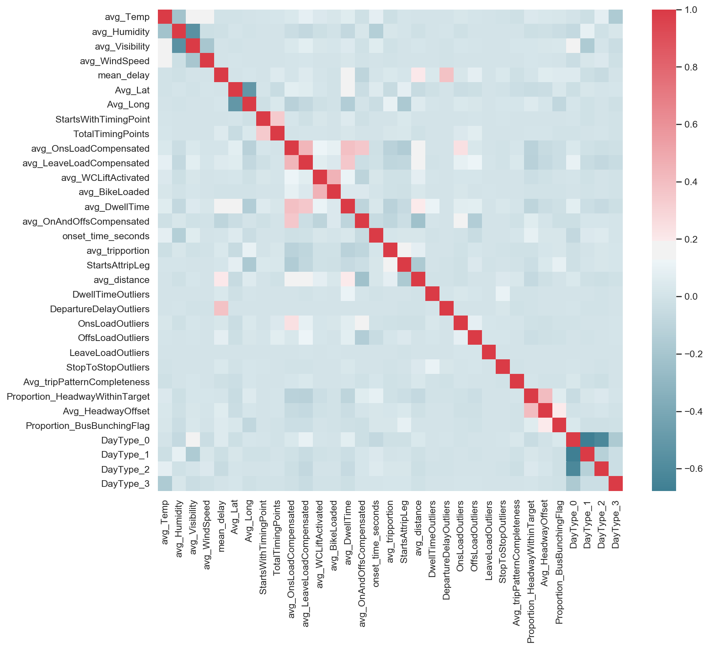
Delay event clustering 2
Analyzing correlation
Pandas & Seaborn
Before & after feature reduction

Slide 10
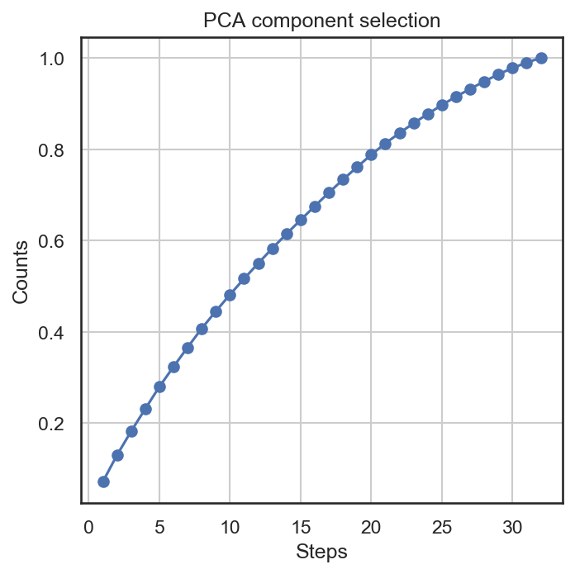
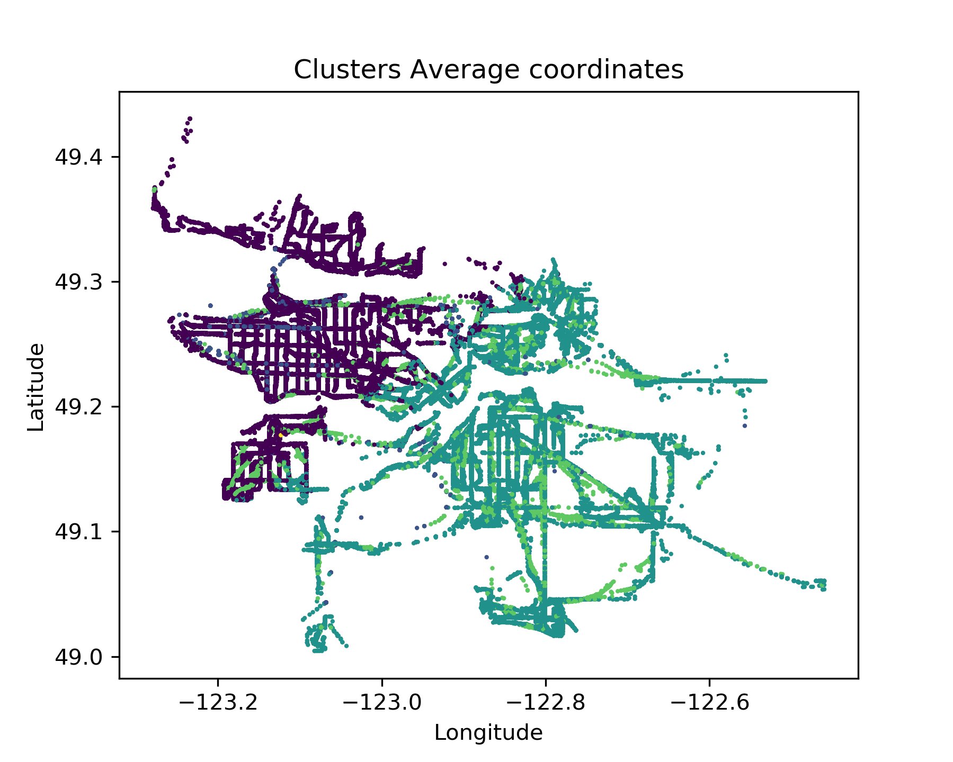
PCA & K-Means clustering
Principal Component Analysis for dimensionality reduction
Highly efficient on data with correlated features
Not that effective on uncorrelated data
2D location plot does not show enough information
Solution: active dashboard

Slide 11
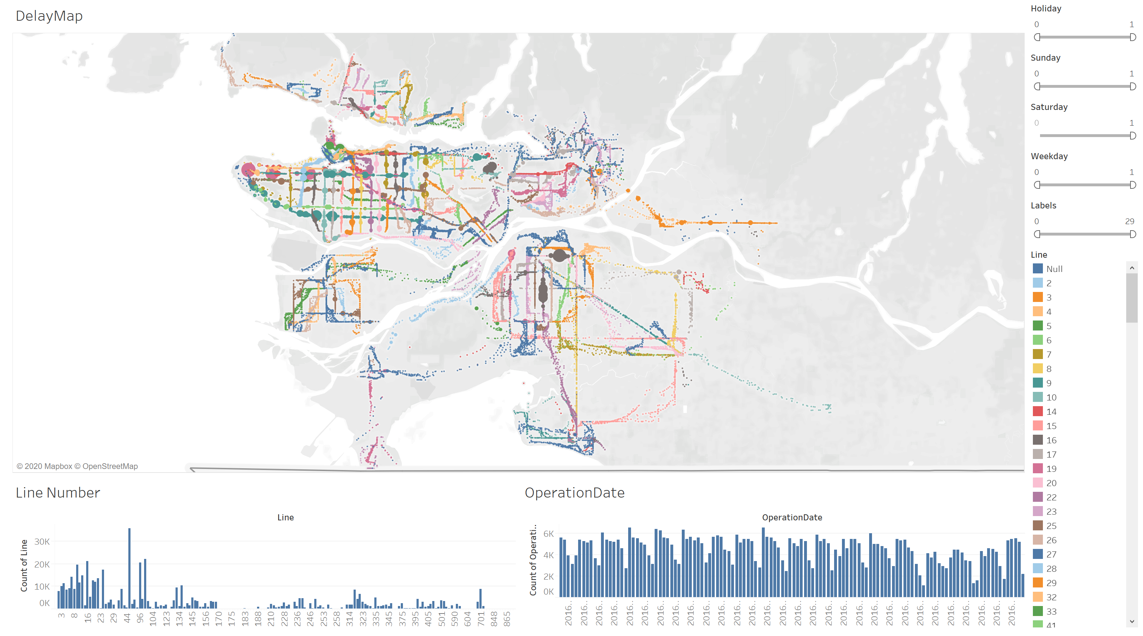
Dashboard visualization
Size of points shows number of delay events

Slide 12
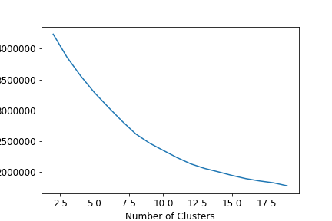
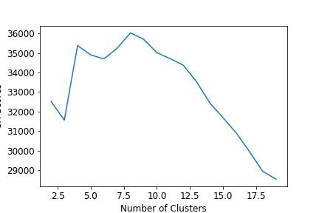
Delay event clustering 3
PCA & K-Means++
8 clusters identified
23 features, 11 principal components (~70% explained variation)
Inertia
CH Score

Slide 13
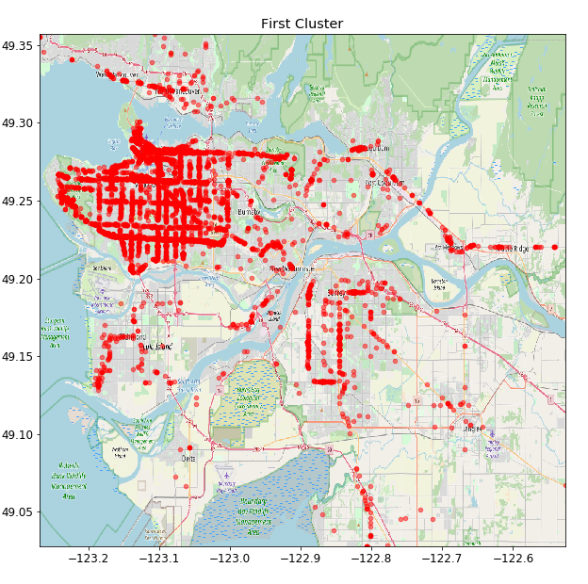
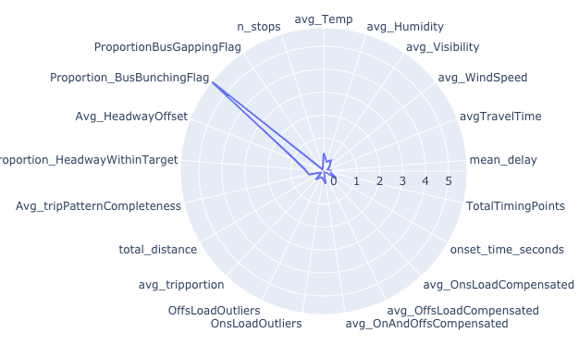
Cluster 1: bus bunching
Concentrated in Vancouver

Slide 14
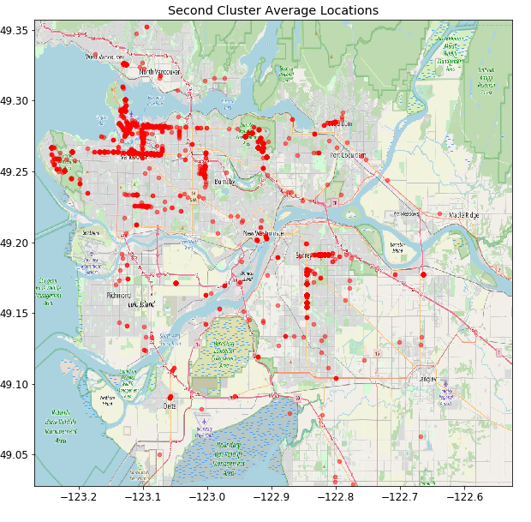
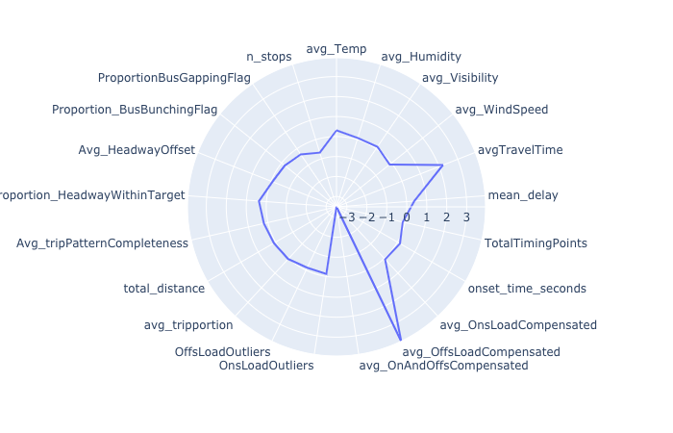
Cluster 2: off-loading
Highlights big transit hubs: downtown, broadway, UBC, SFU, BCIT, …

Slide 15
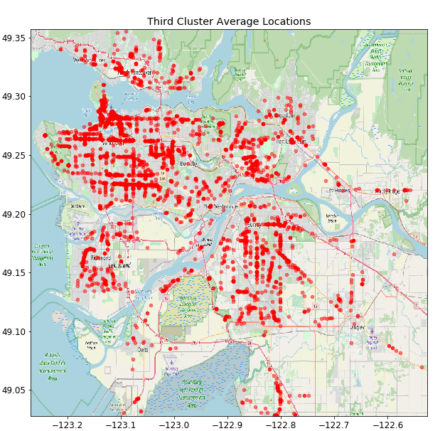
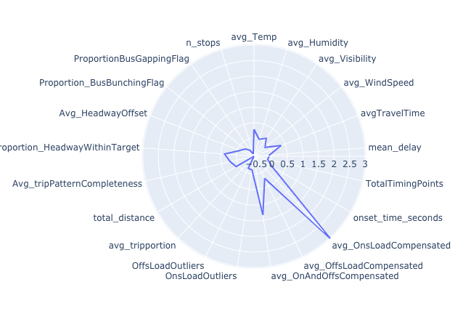
Cluster 3: on-loading
Relatively spread out

Slide 16
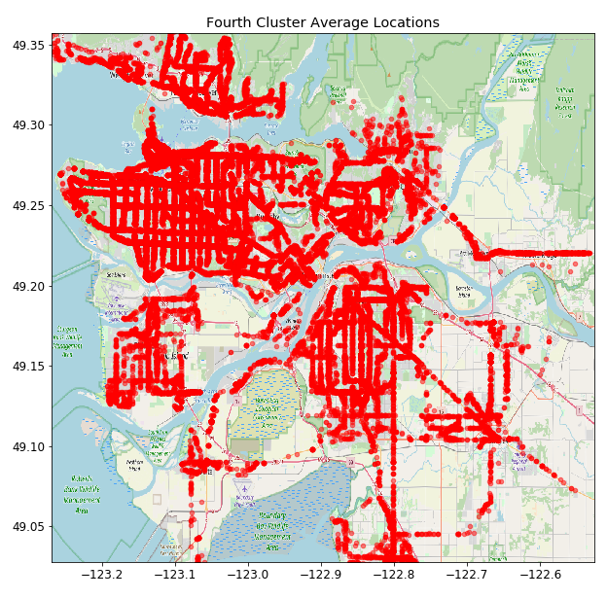
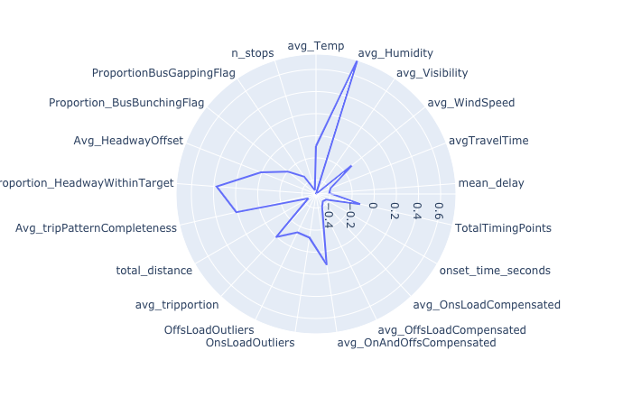
Cluster 4: rain
Data from Fall 2016

Slide 17
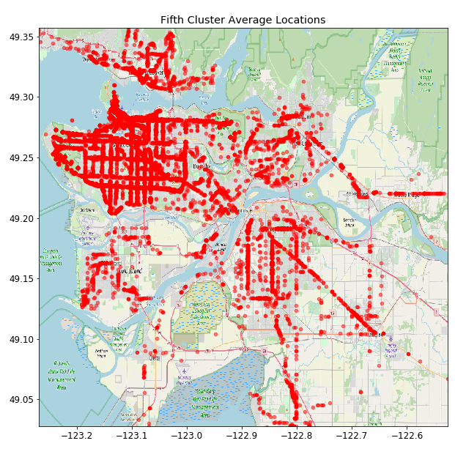
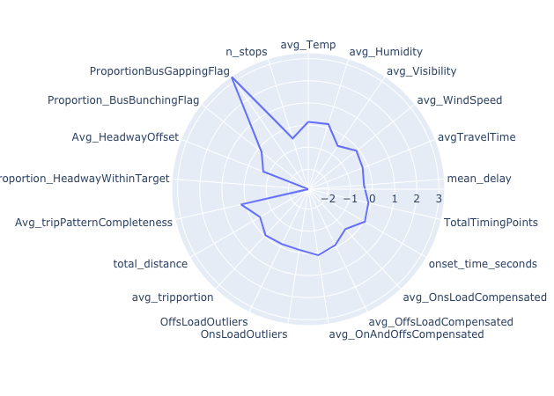
Cluster 5: bus gapping
Negative correlation with ‘headway within target’

Slide 18
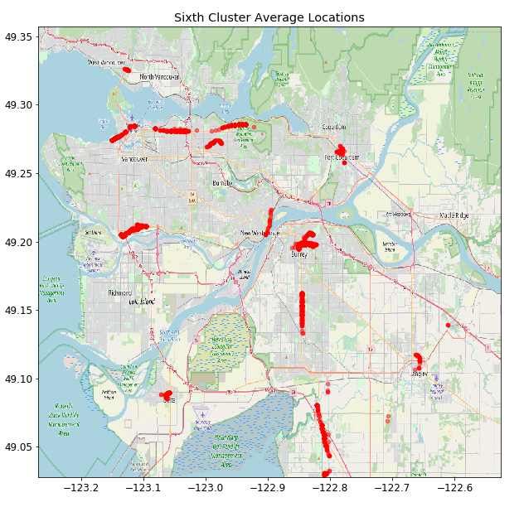
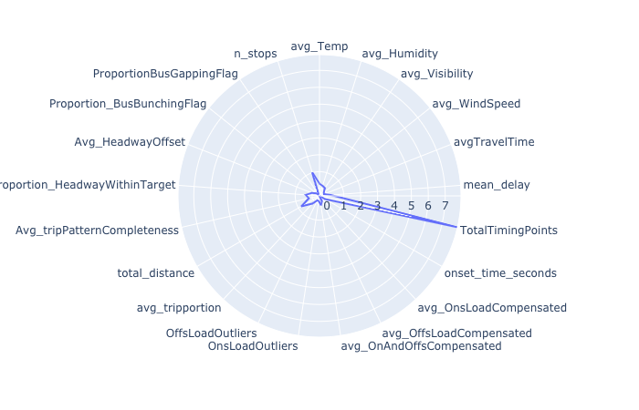
Cluster 6: timing points
Persisting delays

Slide 19
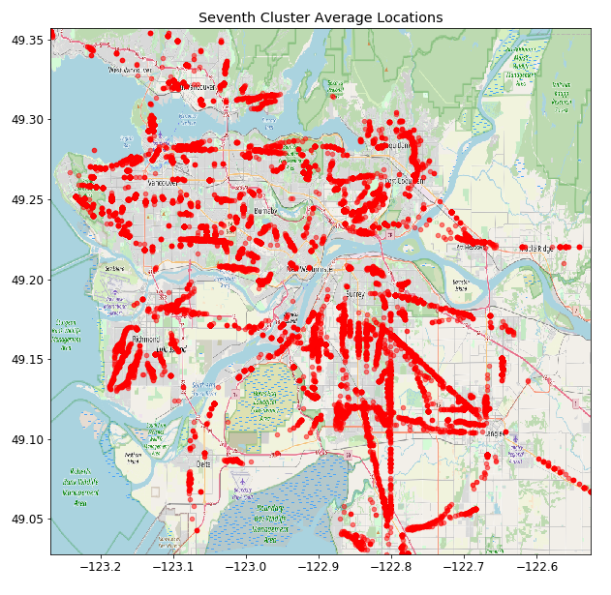
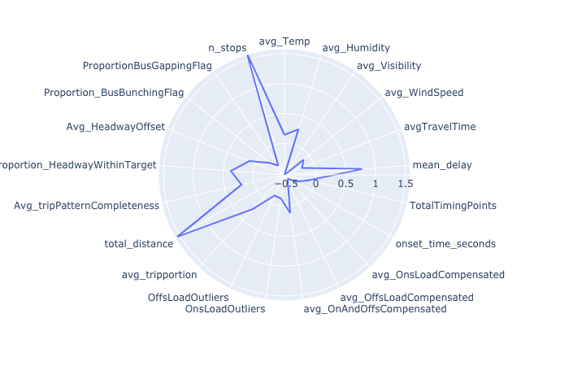
Cluster 7: distance
Long delays in terms of distance/ number of stops

Slide 20
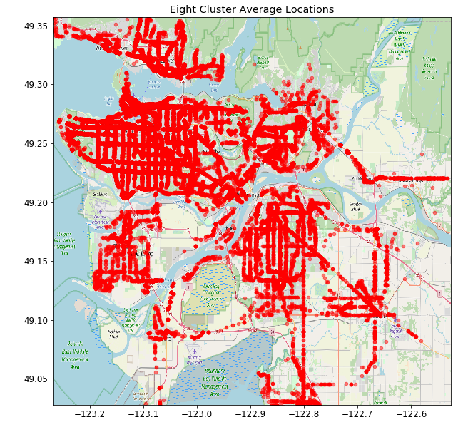
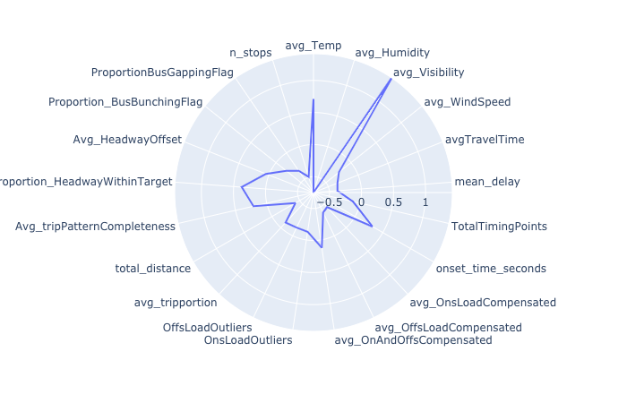
Cluster 8: ?
No apparent reason

Slide 21
Delay event clustering 4
Hierarchical clustering
Challenges
Choosing appropriate distance metric for mixed data
Compute and labour intensive
Imbalance in cluster sizes
Approach
Drop categorical variables
Consider fraction of the total data set
Be patient

Slide 22
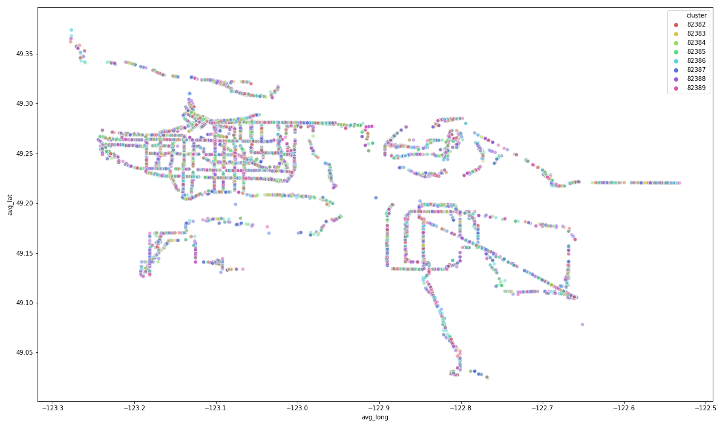
No clear patterns

Slide 23
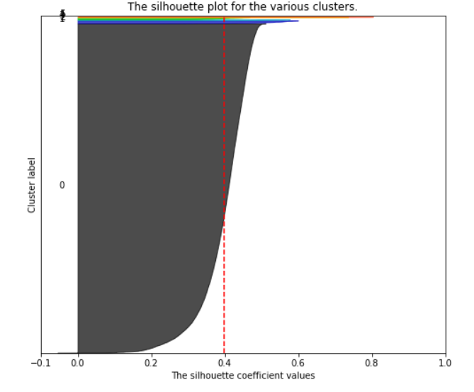
Other approaches?
DBSCAN, OPTICS
Good silhouette score only when:
GMM, BGM
K-means simply got better scores!

Slide 24
Key take-aways
Multiple ways to get insight into the dataset
K-Means(++) led to the best results
Smart visualization goes a long way

Slide 25
If we had more time…
Further analysis hierarchical clustering results
Include categorical features
Optimize parameters
Better cluster identification (radar plots?)

Slide 26
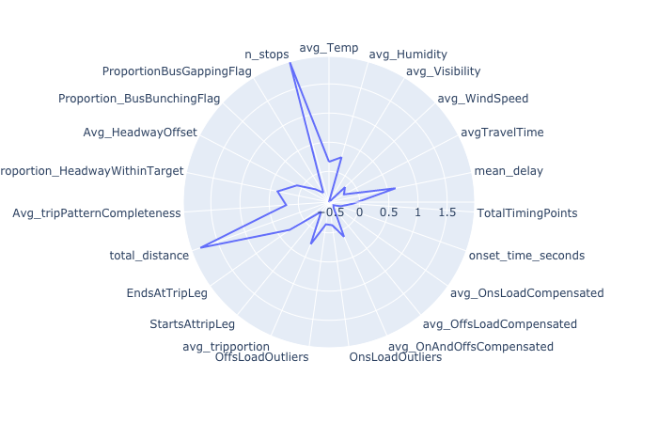
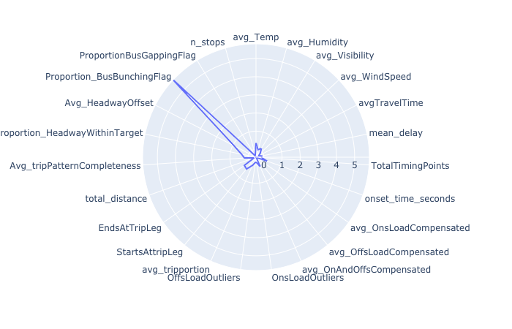
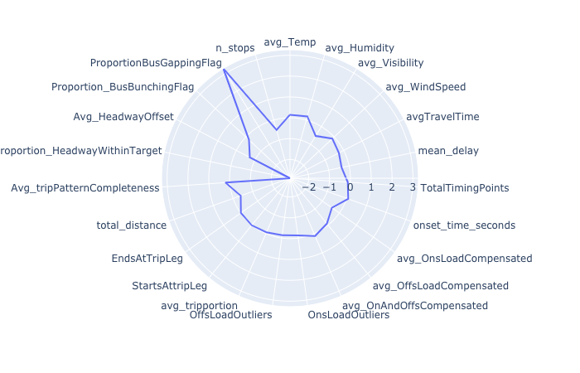
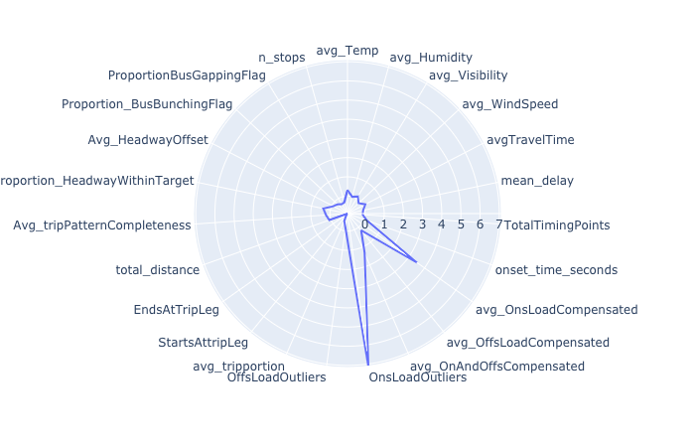
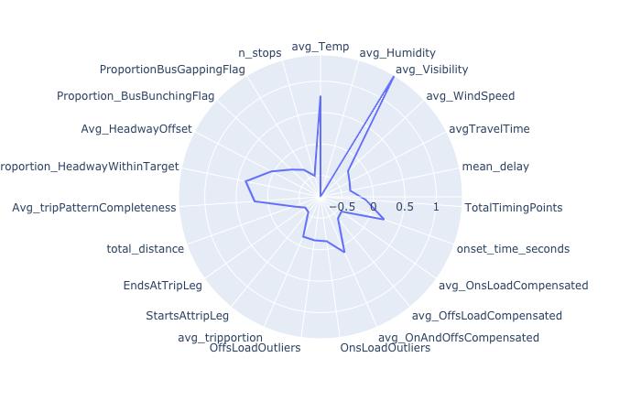
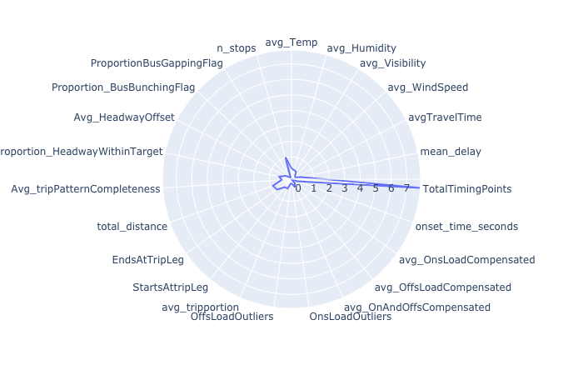
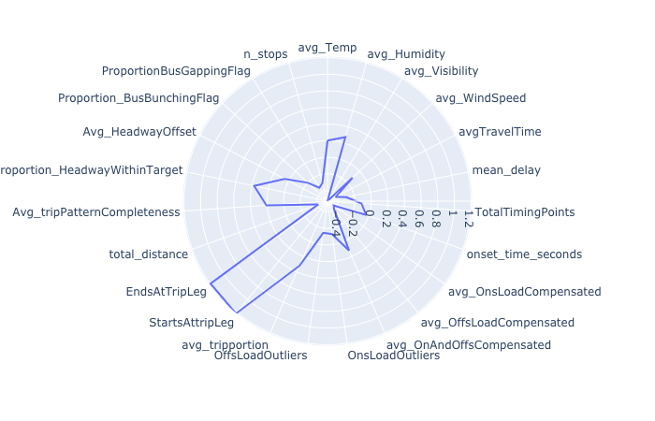
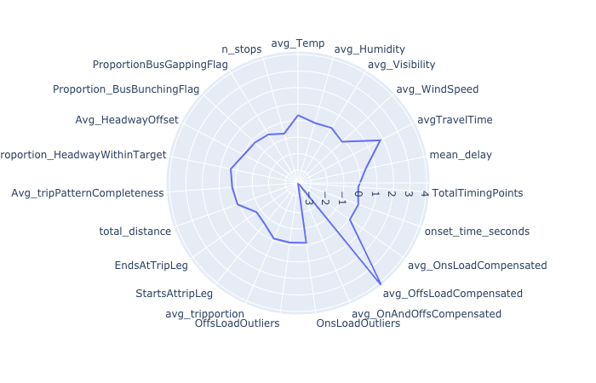
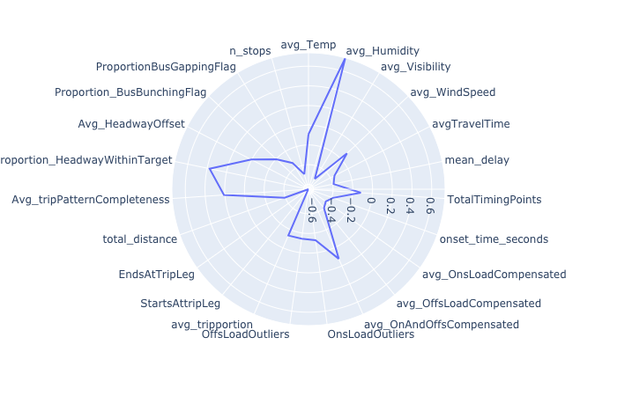
Cluster visualization

